Slide 1
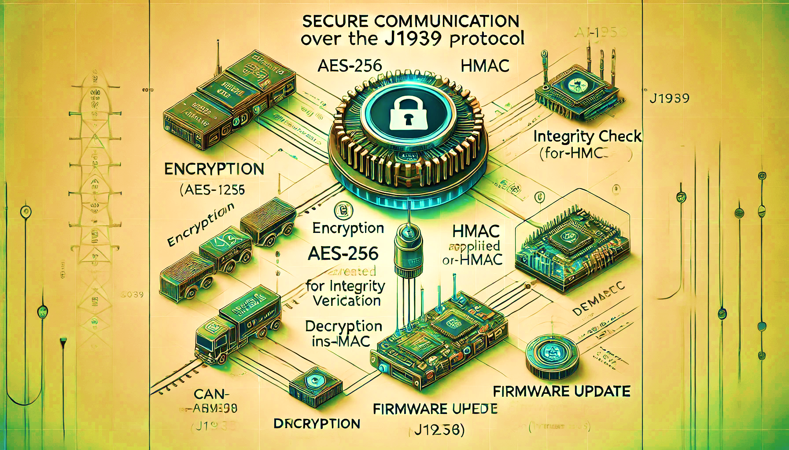
AI Generated
J1939 Secure Communications
SockBurst

Slide 2



Team SockBurst
Piyush Kumar Choudhary (SPOC)
Implemented and designed Custom Bootloader and firmware for programmer and receiver node.
4th year undergraduate student at IIT Kanpur (BS PHYSICS)
Shiv Bhushan Tripathi
Implemented J1939 protocol stack ensuring node-to-node file transfer.
PhD student at IIT Kanpur (CSE)
Pravin Tanpure
Modified existing AES256-CBC for usage in receiver node firmware, incorporated HMAC algorithm.
3rd year undergraduate student at IIT Kanpur (BS PHYSICS)

Slide 3
J1939 Secure Communications Problem Statement and Task description.
Task description :
AES256-CBC, HMAC based encryption methodologies should be used for the secure CAN communications to upload firmware files to the GD controller.
At sender, we should encrypt the file via AES256-CBC algorithm, generate 64 bytes HMAC code using HMAC algorithm, Append HMAC code at the end of the file, and then send the file via J1939 transport protocol.
Receiver upon receiving should store the file in data flash, retrieve HMAC code from the file, generate HMAC code of the received file and verify file integrity via HMAC algorithm, decrypt file block by block using AES256-CBC algorithm and flash decrypted file to code flash.
Problem statements :
Implementation of J1939 Protocol stack.
Implementation of J1939 Transport protocol for node-to-node file transfer.
Implementing AES256-CBC algorithm for encryption and decryption.
Implementing HMAC algorithm for integrity verification of file.

Slide 4

Our design, implementation and Approach.

Slide 5

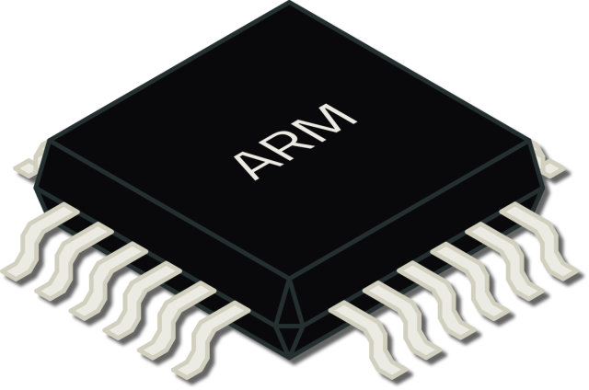


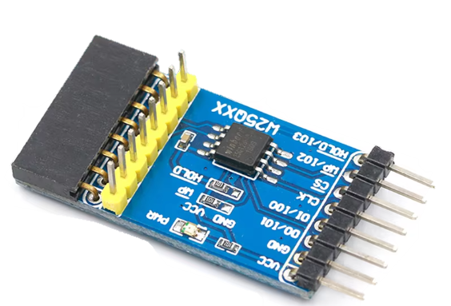
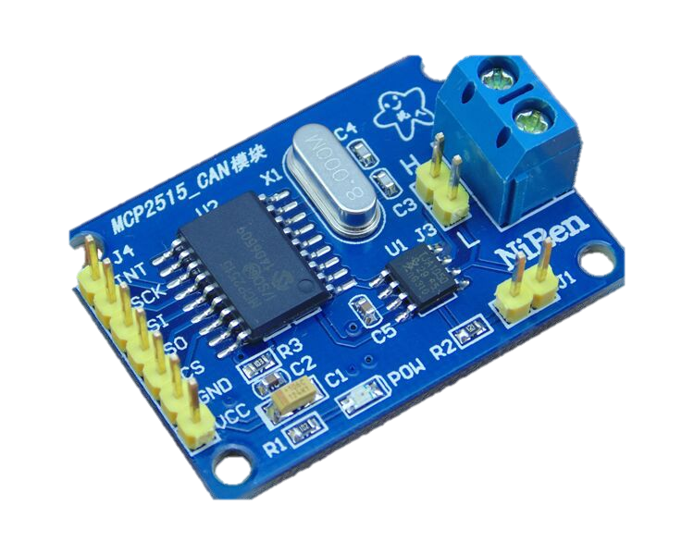

Controller Area Network Block Diagram
Nucleo-STM32F401RE
512KB flash
96KB SRAM
Nucleo-STM32F401RE
512KB flash
96KB SRAM
Node
Receiver
Node
Programmer
SPI
SPI
USB bridge
SPI
SPI
Data flash
MCP2515
Data flash
MCP2515
CAN
CAN

Slide 6
MCP2515 CAN Bus module
Receives Binary signals
from MCU and converts them into differential CAN signals and vice-versa.
CAN
SPI
SPI
Power machine like x86/x86-64/ARM running Linux.
Performs the AES256-CBC encryption and HMAC calculations.
Flashes it onto Data flash using ‘dd’ utility.
Nucleo-STM32F401RE
512KB flash
96KB SRAM
Nucleo-STM32F401RE
512KB flash
96KB SRAM
SPI
Node
Node
Receiver
Programmer
USB bridge
SPI
Receiver node, typically
STM32F401 microcontroller executing CAN-J1939 protocol stack, security algorithms and flash update routines.
Secured firmware will be stored into this Data flash and then any required algorithms will be executed on it.
Programmer node, typically STM32F401 microcontroller executing CAN-J1939
Protocol stack.
Reads secured firmware from Data flash.
Stores the secured firmware generated by power machine.

Slide 7

Data flash flashing with secured firmware :
Data flash can be flashed easily with secured firmware using ‘dd’ utility which is available on Linux.
But flashing the firmware is not enough alone, we‘ve to explicitly tell the programmer node about the size of the firmware, this can be done by storing the firmware size in initial 4 bytes of the last sector of the data flash, following steps can be executed to make Data flash ready for deployment.
A C program can be used for this purpose which just need the firmware file, it will calculate its size, then write it to a .bin file and then execute the ‘dd’ utility to write to the Data flash, Completion of this program means the Data flash can be used for firmware updates.
‘dd’ utility syntax :
dd if=input_file of=/dev/sdX bs=512 seek=sector_number count=1

Slide 8
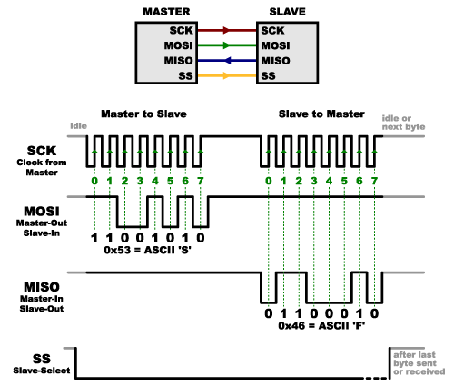
SPI (Serial Peripheral Interface) protocol :
SPI protocol is used intensively in our implementation, SPI serves as interconnect between MCU and CAN bus module, MCU and Data flash.
Before using the SPI protocol, underlying SPI hardware must be configured. In our implementation, MCU acts as master thus provides clock for the communication and MCP2515 CAN bus module acts as slave.
Since SPI is full duplex communication protocol, thus as master clock
pulses, both master and slave shifts out data on SPI bus bit by bit in
synchronization with clock pulses, this leads to exchange of dummy
bytes even during transfer of useful data, thus the high-level software (HAL in conjugation with firmware) must handle and parse the received bytes to filter off relevant data and discard the dummy bytes, this software implementation totally depends on slave device architecture like how it accepts commands, arguments and sends out requested data.
SPI protocol itself doesn’t handle data parsing and filtering.
SPI : Data-link layer
protocol / L2 protocol
USB bridging will connect the SPI based data flash to the computer via a SPI to USB inter-converter, on USB side. Linux will take care of programming.

Slide 9
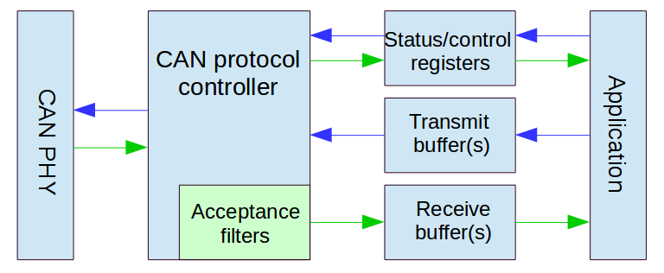
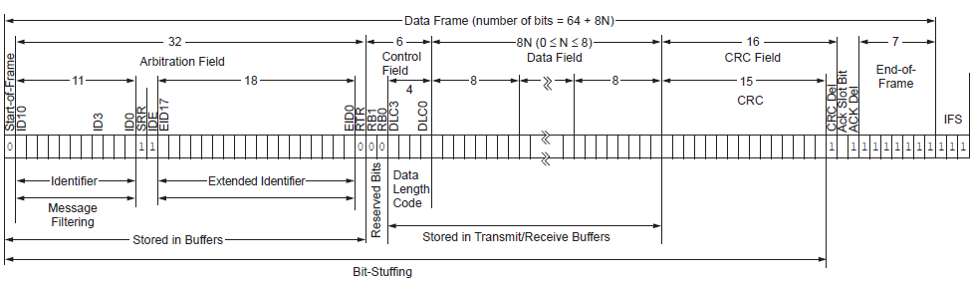
CAN(Controller Area Network) protocol :
CAN has multiple variants like CAN 2.0A, CAN 2.0B, CANopen etc, we’ll be using CAN 2.0B (extended CAN) which has 29 bits identifier field, Its backward compatible with CAN 2.0A as well.
Data-link layer implementation is handled by MCP2515 CAN bus
module which sends out data to other nodes on top of CAN bus
encapsulated in CAN frame, size of this CAN frame depends on choice of CAN variant, for CAN 2.0B, size of each frame excluding
Interframe space is typically 128 bits.
CAN is multi-layered protocol spanning physical and data-link layers.
Extended data frame, SRR and IDE always 1, RTR depends on whether frame contains data (0) or data request (1).
Each CAN frame carries only 8 bytes of data and since we’re using J1939 on top of CAN, thus Data[0] will be used by J1939 Transport layer for frame sequencing, thus only 7 byte of firmware data will be transferred per CAN frame, since only 1 byte is used for frame sequencing, thus one J1939 packet can hold max up-to 1785 bytes (7*255).

Slide 10

J1939 Protocol :
J1939 is core industrial protocol used in large machineries and automotive vehicles. J1939 uses CAN as its physical layer protocol to ensure communication, the application layer of this maps the data and ID into a buffer which is then passed to the transport layer which in turn write the relevant data of CAN frame like 29 bits ID, 8 bytes data, IDE and RTR bits and then sets transmission request bit in ‘TXRTSCTRL’ register using MCP2515 drivers.
Application layer is responsible for handling type of data being sent (PGN), Receiver/Transmitter node address, node address management using networking layer, decision making for transport layer handler type (broadcast/P2P).
Transport layer is skipped if the size of data to be sent is 8 bytes or less, in this scenario, application layer will directly call MCP2515 drivers to transport the data. In our case, the entire data has to be grouped into multiple J1939 packets since J1939 allows addressing up-to 255 frames for each packet because of the protocol design.
J1939 is multi-layered protocol spanning Application layer and transport layer, though spans some part of Networking layer as well via node addressing.
Transport layer handlers are of two types, BAM (Broadcast Announcement Message) and CMDT (Connection Mode Data transfer). As per our deliverables, we need to implement CMDT for node-to-node file transfer.

Slide 11
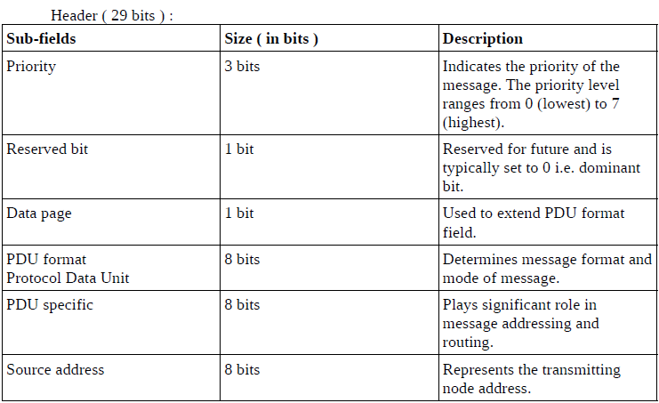
J1939 Application layer :
J1939 packet has two fields, header field(29 bits) and data field(0-1785 bytes), this layer one-to-one maps the header field to extended CAN ID.
Let’s look at this header field :
Header field is generated by application layer depending on type of information the underlying CAN frame will be carrying.
PGN is an important parameter which plays key role in message identification, routing and addressing, it’s a collective field of size 18 bits(needs 5 hex digits) spanning reserved bit, data page bit, PDU format bits, PDU specific bits, thus it can be derived from CAN ID but vice-versa needs additional information like priority bits, source address etc.
PDU Specific field represents Destination ECU address if the PDU format field lies in range [0x00, 0xEF] because only these value represents node specific messages, other values corresponds to different types of broadcast messages, In this case, PS field works as group extension for PF field for
addressing more broadcast message types.
(PF)
(PS)
PGN e.g. : 0x(p)(qr)(st)
RB and DP
PF
PS
PGN = (RB<<10) | (DP<<9) | (PF <<8) | (0x00)
If PS <= 0xEF since PS corresponds to receiver ECU address.
PGN = (RB<<10) | (DP<<9) | (PF<<8) | (PS)
If PS > 0xEF since PS doesn’t represents any ECU address.
If PF <= 0xEF
PGN = 0x(p)(qr)(00), PS = Destination address

Slide 12
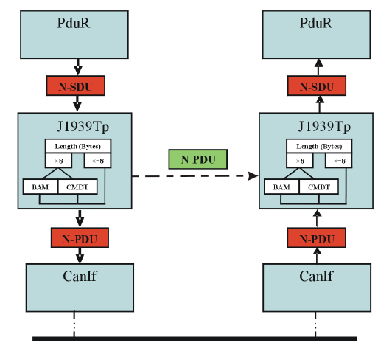
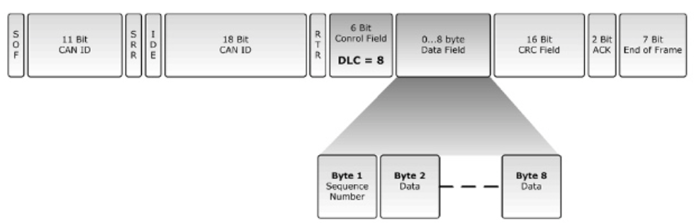
CMDT (Connection Mode Data Transfer) :
The Connection Mode Data Transfer (CMDT) protocol is used when data needs to be transferred to a specific destination, often in a request-response scenario. It involves handshaking between the sender and receiver to control the flow of the message. the CMDT protocol uses the Connection Management (TP.CM) and Data Transfer (TP.DT) frames. It includes additional frames for managing the handshake between sender and receiver.
In TP.CM, there are 4 type of frames(each carry different information) (PGN : 0xEC00):
> CMDT TP.CM_RTS ( Request To Send ) (send by programmer)
> CMDT TP.CM_CTS ( Clear To Send ) (send by receiver)
> CMDT TP.CM_EOM_ACK ( End Of Message ACK )
> CMDT TP.CM_ABORT
In TP.DT, only one type of frame is there (PGN : 0xEB00):
> CMDT TP.DT (Data frame)
Each of these frames have same header field but different data field.
Since TP.CM are specific frames for connection management, thus have
specific PGNs which is fixed (PGN : 0xEC00 (PF<=0xEF -> PS=0x00)), look at
the PGN list here for more details.
J1939 Transport layer interactions

Slide 13
TP.CM/DT data field structures :
TP.CM_RTS :
Byte 0 : Control byte (0x10) (RTS)
Byte 1-2 : Data size (upper limit 1785 bytes)
Byte 3 : Total frame count (Data_size/7)
Byte 4 : Frame count the sender can send in one go
Byte 5-7 : PGN for data being transferred in TP.DT frames
TP.CM_CTS :
Byte 0 : Control byte (0x11) (CTS)
Byte 1 : No. of packet receiver can accept in one go
Byte 2 : Sequence number of next frame (used for
continuation of communication after an interval)
Byte 3-4 : Reserved
Byte 5-7 : PGN for data being transferred in TP.DT frames
TP.CM_EOM_ACK :
Byte 0 : Control byte (0x13) (EndofMsgACK)
Byte 1-2 : Total number of bytes received
Byte 3 : Total frames received
Byte 4 : Reserved
Byte 5-7 : PGN for data being transferred in TP.DT frames
TP.CM_ABORT :
Byte 0 : Control byte (0xFF) (connection abort)
Byte 1-2 : Connection abort reason
Byte 3-4 : Reserved
Byte 5-7 : PGN for data being transferred in TP.DT frames
TP.DT :
Byte 0: Frame sequence.
Byte 1-7 : Actual data in chunks of 7 bytes.
Firmware transfer and updates are unlikely to occur under adverse conditions; however, if they do, it is crucial to prioritize CAN frames for firmware transfer. This can be achieved by setting the J1939 header field to the lowest possible value, as CAN frames with lower CAN IDs win arbitration, ensuring that the corresponding frame is transmitted first and minimizing the risk of collisions.
Networking layer in J1939 protocol stack offers node addressing capabilities like run-time node identity modification, node deletion etc. More details about J1939 protocol stack can be found here.
J1939 protocol stack block diagram is given on next slide.

Slide 14
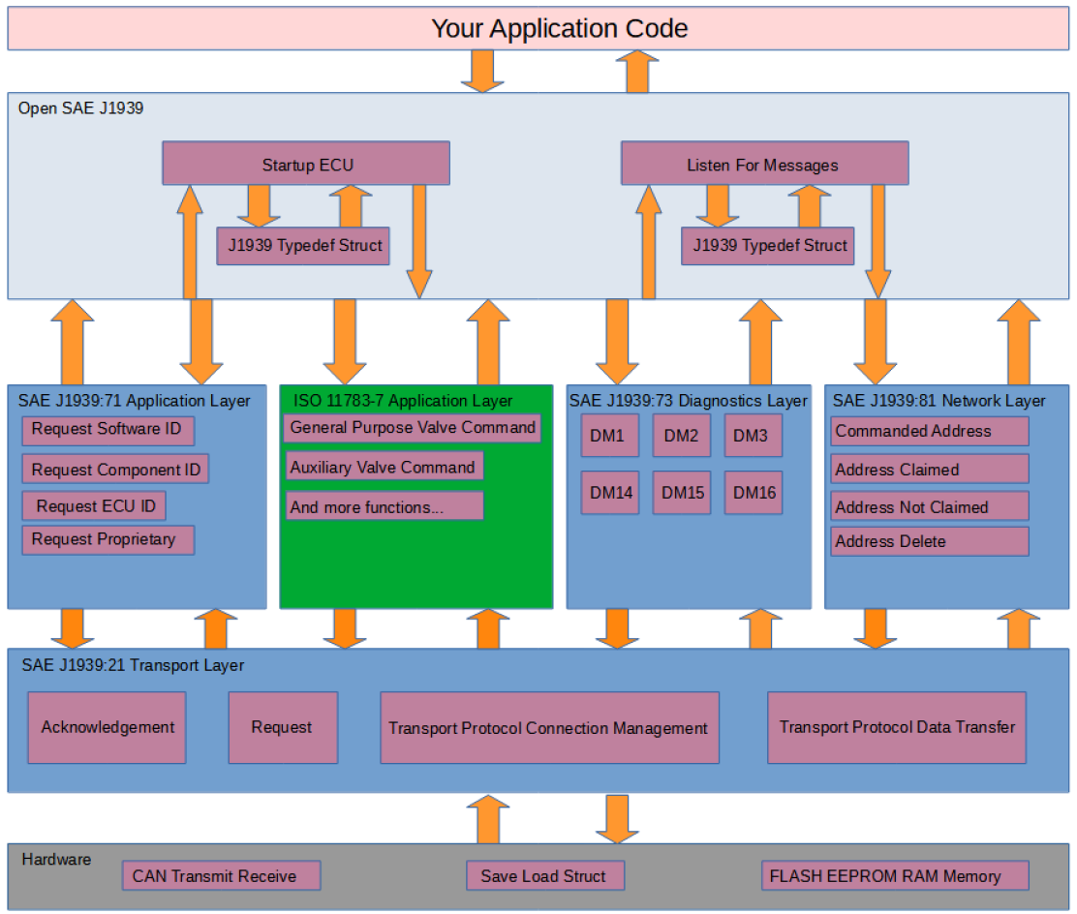

Slide 15
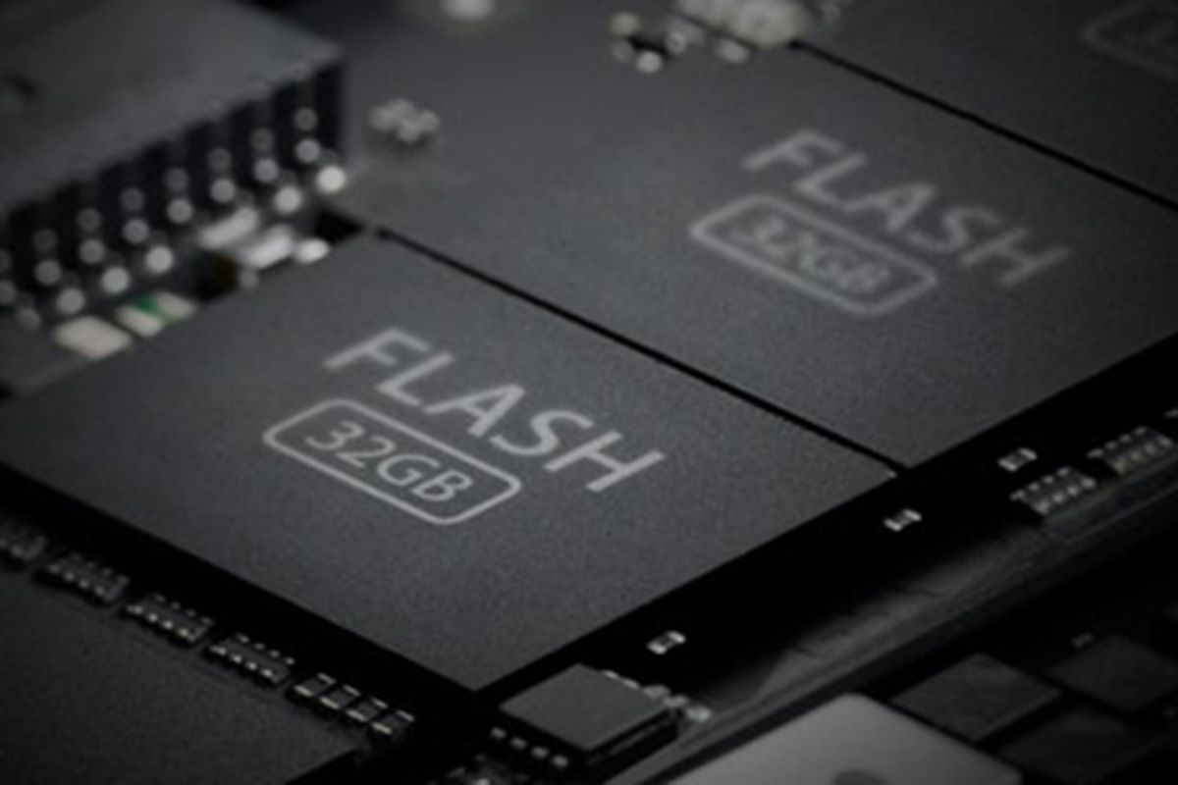
Usage of peripherals, design and implementation depends on the choice of firmware design for both “Programmer” and “Receiver” node.
Let’s discuss how the firmware is designed on both nodes ensuring flawless communication and firmware updates.
Programmer node firmware design and memory layout :
System initialization, peripheral initialization, CAN-J1939 communication routines.
(.text section)
Program data
(.data section)
(load region)
Contains system and user data
I V T
Read only data
(.rodata section)
This firmware design is fixed until some more functionalities are not needed to be added, only secured firmware will change depending on the functionality need to be updated on receiver node.
Flash layout and .bin file structure
0x0800-0000
0x0807-FFFF
512 KBs
The secured firmware will be sent in chunks of 1785 bytes by reading it from Data flash to SRAM and then will be sent over CAN-J1939 Protocol to the receiver node, this ensures sufficient processing time for receiver node to process the data and re-assemble it into Data flash.
Block size of 1785 bytes is chosen to tackle the problem with J1939 CMDT transport layer handler, it provides only 1 byte to frame sequencing, thus any block size larger than 1785 will cause an overflow situation.

Slide 16
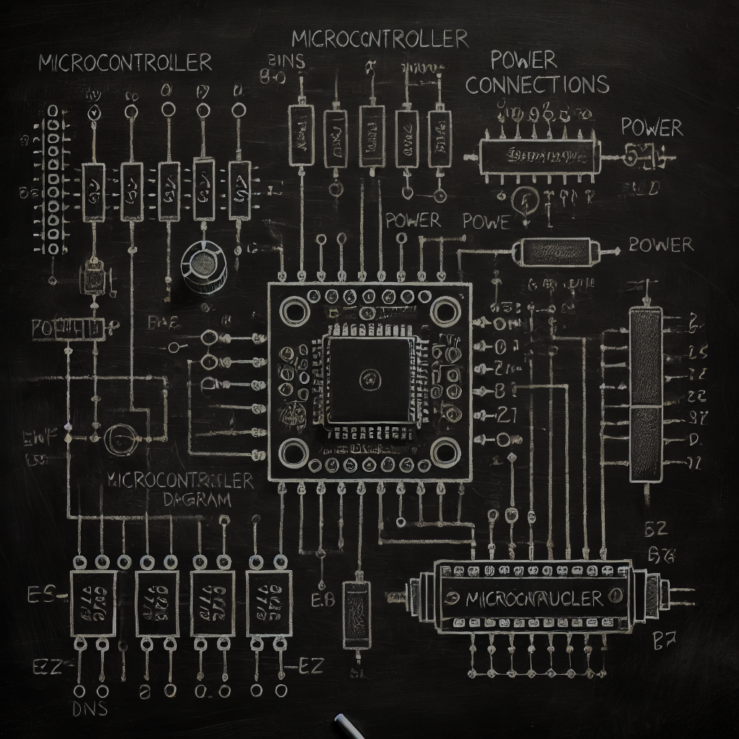

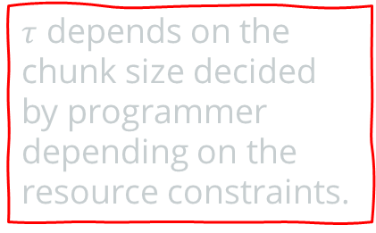

Time domain chart for communication initialization and processing :
Communication begin
CAN-J1939 communication initialization
Secured firmware transfer in chunks (1785 B)
Programmer MCU
Receiver MCU
Processing period, no data transfer
Secured firmware transfer in chunks (1785 B)
$$τ$$
Processing period, no data transfer
Time
Cycle continues till entire firmware transfer
$τ$ depends on the chunk size decided by programmer depending on the resource constraints.
Communication end
This time–domain diagram represents ideal communication scenarios ignoring real-world problems like power failures or unpredictable system resets.
Such scenarios are handled for communication state recovery by triggering a query to the receiver node which in turn responds with its communication state information.

Slide 17
More details of programmer firmware.
System initialization, peripheral initialization, CAN-J1939 communication routines.
(.text section)
Program data
(.data section)
(load region)
Contains system and user data
I V T
Read only data
(.rodata section)
0x0800-0000
0x0807-FFFF
Typical ISR routine addresses like NMI, hard fault, EXTI for MCP2515 etc.
Program data like J1939 structures, CAN structures and others which will be copied to SRAM during system initialization by startup code.
System clock Initialization at 16MHz, SPI1 initialization at 8MHz (for MCP2515), SPI2 initialization at 16 MHz (for Data flash). These clocks are derived from main system clock thus appropriate pre-scalars must be set in clock configuration registers. MCU behaves as SPI master.
Read only data like constant addresses for memory and register access.

Slide 18
Exclusive properties of programmer node firmware :
Auto communication state recovery on receiver’s instruction offering resumed and robust communication across power failures and system resets. This is done during CAN-J1939 initialization with a firmware transfer query using extended remote frame, triggered by programming node, receiver node will respond with command instructing fresh or resumed firmware transfer.
Strict usage of static memory allocation avoiding run-time memory allocation and fragmentation issues, ensuring compatibility with industrial standards like MISRA C.
Avoids unnecessary resource usage on programmer node by doing security algorithm computation on PC, this allows the programmer node to be chosen with limited resources that can handle CAN-J1939 protocol stack only.
block0
Programmer’s communication state recovery query
If
command
block1
While(1)
get_block()
block2
block3
Receiver’s command
!command
block(N-2)
block(N-1)
Communication state recovery
block(N)

Slide 19
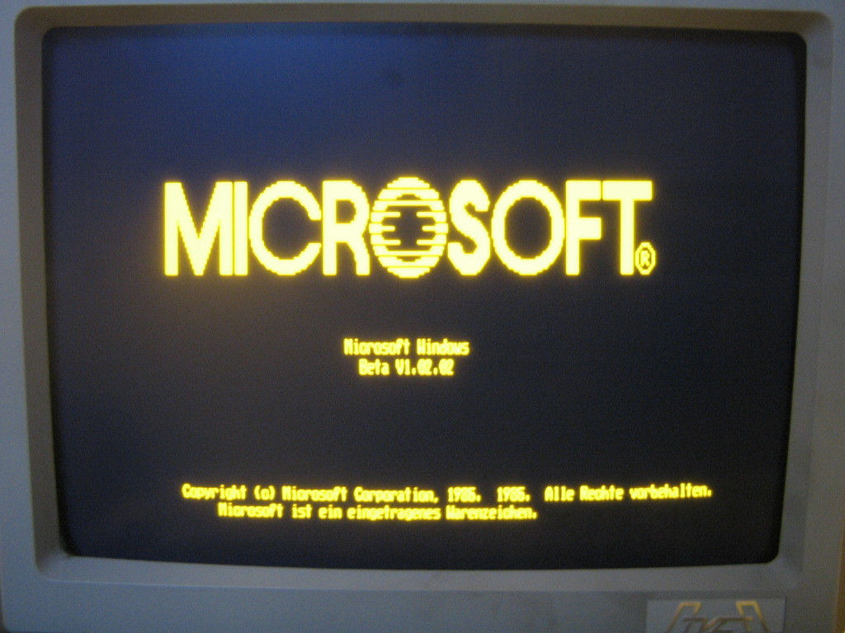
Programmer node boot-up and program flow :
Direct booting from flash memory by boot pins configuration on MCU.
Low level hardware initialization by Reset handler.
Jumping to main firmware for firmware transfer.
Communication state recovery information exchange between programmer and receiver nodes.
Programmer nodes enters low power state after ‘disconnecting peripherals from supply’/’ firmware transfer’.

Slide 20
Receiver node firmware design and memory layout :
Creating a usable Receiver MCU :
All ECUs to be used in industrial machineries/automatic vehicles must be first flashed with a special firmware called “Custom Bootloader” which offers robust and reliable firmware update state recovery across power failures and system resets.
All security algorithms and update routines are implemented in this custom bootloader.
Let’s look at the memory layout of this custom bootloader.
Program data
(.data section)
(load region)
Contains system and user data
IVT : basic ISRs like NMI, hard faults etc.
.text : contains routines for security applications (AES and HMAC) and update routines, SPI initialization.
.rodata : contains security algorithm data like KEY/IV/S boxes/Constant matrices.
.data : contains modifiable data for bootloader like subsequent IVs.
System initialization, SPI initialization, firmware update, pseudo File System routines.
(.text section)
I V T
Read only data
(.rodata section)
0x0800-0000
0x0807-FFFF
Custom Bootloader size ~ 128KB
512 KBs
SRAM layout for this custom bootloader will be similar to that of typical firmware since SRAM generally contains stack, .data and .bss and its enough for our implementation.

Slide 21
Exclusive properties of receiver node custom bootloader :
Handles the firmware security execution and updates avoiding repetitive inclusion in new firmware on each update, independent of the underlying communication mechanism for firmware transfer, thus can be used with other physical layer protocols.
Auto-recovery of firmware update state offering robust and resumed firmware update including both security execution and flashing. This is done via a system reset by the receiver node on firmware transfer completion (now the firmware is in receiver’s Data flash), on reset, bootloader checks for pending system updates by reading a sector of Data flash which store system state information for firmware updates, thus offering reference for the new firmware development which must be strictly followed.
Binds SPI communication routines into it, thus receiver firmware can directly use the addresses of those routines to communicate over any SPI channel.
Strict usage of static memory allocation avoiding run-time memory allocation and fragmentation issues, ensuring compatibility with industrial standards like MISRA C.
Pseudo file system implementation for Data flash offering high level APIs to interact with Data flash, receiver node firmware must use these APIs via function pointers to interact with Data flash, though low-level access is also possible using SPI drivers. This API is designed such that even access to the bootloader critical fields in data flash from firmware doesn’t corrupts any information because bootloader fields are used during firmware update only.
Configures the system into a knows state like configuring system clock etc which need not to be done by firmware again unless explicitly needed.
pFS APIs are designed in a way that the firmware region can be used to store some other large data via the same routine(must be done with caution)
.bin file flashing capabilities avoiding records/data parsing, thus speeding up the flashing process. Also .bin file is typically very small in size as compared to .hex file.
Ensures that SRAM, prefetch buffer and caches (both ‘i’ and ‘d’ caches) are all flushed before jumping to the firmware.

Slide 22
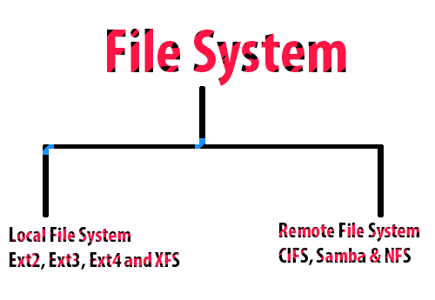
Data organization and pseudo file system
implementation on receiver’s Data flash :
Data flash on receiver node stores critical information without which the entire implementations seems to be uncompleted. Along with the received firmware, it stores critical system state recovery information for both communication and update processes.
All the information and firmware which is stored in receiver’s Data flash
is stored in an organized way.
This FS contains only 2 sections for now (can be extended in future),
Sector 0 : keeps update and communication state recovery information.
Sector 1-N : received firmware/user data
This FS offers an API which the firmware can use to access the Data flash in a systematic and secure manner.
For accessing the Sector 0 fields, specific macros are defined for field addresses and sizes, thus passing those macros to API routines will help
accessing critical fields.

Slide 23
0x00…0
Data flash Sector size : 512 Bytes
0xFF…F
Sector 0
Secured firmware with IV and HMAC code.
Sector 2 – Sector N
0x0000
Byte to be filled by firmware before reset for bootloader to execute security and update routines after reset.
(uint8_t)
Byte 0
Byte 1-4
Byte 5-8
Contains critical information for system state recovery during firmware update.
Byte 9-12
Bytes used by bootloader itself
for storing the security progress/check-points. (uint32_t)
Byte 13-16
Byte 17-20
Bytes used by bootloader itself
for storing the firmware update progress/check-points.
(uint32_t)
Bytes used by firmware to store the communication state like 1785B block count. (uint32_t)
Reserved for future
Entire Firmware size received at beginning. (uint32_t)
Firmware address in data flash, must be set for updating the firmware. (uint32_t)
0x01FF

Slide 24
More about custom bootloader :
Placed in “pFS” section for being used by firmware
typedef struct {
void (*Read)(uint8_t*, uint8_t* ,uint32_t)=read;
void (*Write)(uint8_t*, uint8_t*, uint32_t)=write;
} pFS_ops ;
Placed in “Spi” section for being used by firmware
Program data
(.data section)
(load region)
Contains system and user data
System initialization, SPI initialization, firmware update, pseudo File System routines.
(.text section)
typedef struct {
/**
* appropriate pointers to
* SPI routines.
*/
} SPI_ops ;
I V T
Read only data
(.rodata section)
// FS API collection.
void read(uint8_t* addr, uint8_t* dest, uint32_t size);
void write(uint8_t* addr, uint8_t* dest, uint32_t size);
0x0800-0000
0x0807-FFFF
Only read-write access is provided to data flash via this API,
Any IOCTL can be carried out by allocating a ‘SPI’ structure and passing it to the exposed SPI routines in firmware.
512 KBs
// SPI routines collection

Slide 25
Bootloader execution with power failure persistence and control transfer to firmware :
Power on
Resuming firmware update
Clearing byte 0 of sector 0
Initializes system with clock and SPI1 configuration
Byte 0 set
Clearing byte 13-16 of sector 0
Firmware update state recovery
Reading Byte 0 of sector 0
Byte 0 not set
HMAC integrity verification
System reset
Jumping to firmware
AES256-CBC decryption
Clearing byte 13-16 of sector 0
firmware
Power failure
Starting fresh firmware update
Clearing byte 0 of sector 0

Slide 26

Bootloader’s transition to firmware :
Transition ahead
Disable IRQs
Clear entire SRAM
Relocate IVT
Linker script for receiver firmware must be carefully modified so that the .hex file contains address relative to 0x0802-0000, not 0x0800-0000.
Flush prefetch buffer, ‘i’ and ‘d’ caches.
Jump to firmware
using an assembly
routine avoiding stack-based C routine calling convention.
Receiver’s firmware share similarities with programmer node’s firmware in context of application specific routines, ISRs etc. Initialization routines like clock configuration, SPI 1 initialization etc are handled by the custom bootloader, though resides at some higher address 0x0802-0000 instead of 0x0800-0000.
Set stack pointer and Instruction pointer(IP/PC)
Firmware Code (IRQs disabled)

Slide 27
Exclusive properties of receiver node firmware :
Very light weight and application specific only like communicating with peripherals and doing computation. No need to take care of security and update routines each time reducing firmware size, transfer and update time.
Written on top of reference provided by the custom bootloader achieving efficient resource management by avoiding repetitive inclusion of pseudo file system API routines, SPI routines, security routines etc.
Strict usage of static memory allocation avoiding run-time memory allocation and fragmentation issues, ensuring compatibility with industrial standards like MISRA C.
Auto communication state recovery by storing number of received blocks(each of 1785 Bytes) into Data flash after copying the block to Data flash from SRAM via the pseudo file system API included in reference provided by custom bootloader, this critical information is sent to programmer node in response to communication state recovery query .

Slide 28
Receiver node firmware execution :
On getting processor control, the firmware will start its typical flow, nothing special till now, but if it receives a firmware transfer communication state recovery query from programmer node, it will then check byte 13-16 (uint32_t) of sector 0, and respond to the programmer node with the firmware transfer state. While checking this field, if value is found to be 0x0000-0000, then a fresh firmware transfer will be initialized else the resumed transfer will be continued.
Communication will either start from a resumed state or a fresh state, the entire firmware data received during this communication is stored directly into the Data flash at some specified address.
Once the entire firmware has been received, byte 0 of sector 0 is marked using write() of pFS API followed by system reset which on next reboot informs custom bootloader to start firmware update. Note that this routine call with specific arguments corresponding to byte 0 of sector 0 must be used in the firmware data reception handler build on top of J1939 protocol as incorrect usage may trigger an unwanted system update which may lead to data and firmware corruption if not handled properly.

Slide 29
Communication state recovery query and response CAN frame structure :
Query and state response CAN frame will be part of CAN initialization, both these frame will be sent bypassing J1939 transport layer, PGNs of such frames has been decided as 0xFF00 (a Proprietary B PGN), lets look at each’s structure.
Query frame
0 0 0 0 0 1 1 1 1 1 1 1 1 0 0 0 0 0 0 0 0 0 1 0 0
1
SA
Data field
0x01 | PGN[2] | PGN[1] | PGN[0]
PGN[3] : 0 | PGN[2] : 0xFF | PGN[0] : 0x01
This PGN is for firmware data.
b0 b1 b2 b3 b4 b5 b6 b7
Response frame
0 0 0 0 0 1 1 1 1 1 1 1 1 0 0 0 0 0 0 0 0 1 1 1 1
SA
Data field
0x02 | Block[3] | Block[2] | Block[1] | Block[0] | PGN[2] | PGN[1] | PGN[0]
PGN[3] : 0 | PGN[2] : 0xFF | PGN[0] : 0x01
This PGN is for firmware data.
b0 b1 b2 b3 b4 b5 b6 b7

Slide 30
Communication begin
Reboot on power failure
Normal communication flow
Recovery decision
Communication state recovery
Programmer MCU
Receiver MCU
$$τ$$
Time
Communication failed due to power failure/system reset
Communication end
Power failure handling during communication.

Slide 31
Making of a usable Receiver MCU with above properties :
Our custom bootloader is compiled into a .hex file and so does our receiver node firmware. This is the first time when MCU is getting programmed out of the machinery, afterwards, firmware can only be updated over CAN-J1939 protocol.
Both the programs are compiled with little modification into their linker scripts so that they can be independently flashed onto the Receiver node at different flash addresses, 0x0800-0000 for custom bootloader and 0x0802-0000 for received node firmware.
Once both the programs have been compiled into individual hex files, each will be flashed onto the MCU via manufacturer’s bootloader which will parse these .hex files and write the changes to the flash memory.
Once the flashing of custom bootloader and firmware has been done, the Receiver node is ready to be implanted into the industrial machineries or heavy-duty vehicles.

Slide 32
Innovations & Uniqueness Compared to Existing Solutions.
Self-programming or In-Application Programming (IAP) is a key innovation in this project, enabling individual nodes to update their own firmware autonomously. Without this capability, the Electronic Control Unit (ECU) would need to be physically removed from the machinery for updates, requiring disassembly—a time-consuming and impractical process. By incorporating self-programming, the node gains the ability to update its firmware seamlessly, enhancing operational efficiency and minimizing downtime.
In comparison to existing solutions, this implementation offers robust node state recovery during firmware transfer and updates in the event of a power failure. This ensures that the self-programming process remains reliable by avoiding retransmission and re-flashing of the entire firmware. Our solution provides persistence across power failures or system resets, enabling the firmware transfer or update process to seamlessly resume from the point of interruption. This capability enhances the reliability and efficiency of the firmware update mechanism.
The use of the HMAC algorithm for firmware integrity verification, in addition to AES-256-CBC or similar encryption methods, enables immediate tamper detection during firmware transfer. If the firmware is altered or compromised in any way, the receiving node can reject the update, thereby mitigating incoming threats and malicious activities. This approach ensures robust protection for the entire CAN network by offering strong resistance against attacks targeting the firmware update process.
The custom bootloader for ECUs, designed for deployment in machinery, eliminates the need for new firmware to include security algorithms such as AES-256-CBC or HMAC, update routines, or SPI interface initialization. Instead, the bootloader provides access to SPI routines through function pointers, enabling IOCTL operations when required. This approach significantly reduces firmware size by avoiding repetitive inclusion of these components, thereby minimizing firmware transfer and update times and further reducing system downtime.
A key innovation of this project lies in the development of the custom bootloader, which is designed with great attention to detail. This bootloader includes a reference manual for firmware development on the receiver node. The manual provides essential details such as the address where the firmware will be flashed, the location for the SPI structure, and the placement of file system APIs. By offering these specifics, the reference manual assists developers in creating lightweight firmware, streamlining the development process and improving efficiency.

Slide 33
Feasibility to Implement.
Technical Feasibility: The proposed solution utilizes widely accepted protocols such as HMAC for integrity verification and AES256-CBC for encryption, ensuring compatibility with existing hardware platforms. The custom bootloader design, which enables self-programming and autonomous firmware updates, integrates seamlessly with the ECUs in machinery. The use of function pointers for accessing SPI routines simplifies firmware architecture, making the implementation technically sound and manageable.
Resource Availability: The necessary hardware resources, such as ECUs with appropriate memory and processing capabilities, are readily available. The software requirements primarily involve low-level programming expertise in embedded systems, C programming, and cryptography, which are well-established in the industry. Tools and libraries for implementing AES-256-CBC and HMAC are also readily available and well-documented.
Time and Cost Efficiency: The design optimizes firmware size and reduces transfer and update times, ultimately leading to cost savings by reducing downtime and minimizing manual intervention. The self-programming feature eliminates the need for physically removing ECUs for firmware updates, further reducing labor costs and operational disruption.
Scalability and Adaptability: The solution is scalable for larger systems, enabling secure firmware updates across multiple nodes within a CAN network. Additionally, it can be adapted to a variety of machinery and applications, making it suitable for a broad range of industries, including automotive, industrial automation, and aerospace.
Risk Management: Potential challenges such as power failures during firmware updates are mitigated by the robust node state recovery mechanism. In case of any system interruption, the update process can resume seamlessly without requiring retransmission or re-flashing, ensuring that the firmware remains intact and operational.

Slide 34
Future Scope & Recommendations.
The custom bootloader is enhanced with functionality to allow the overriding of AES-256-CBC and HMAC keys in the event of key exposure. New keys can be placed in the reserved space of sector 0 of the data flash on the receiver node, with these keys being prioritized over those embedded in the custom bootloader.
The Proof of Concept (POC) was conducted using only two nodes, where the receiver ECU ID is statically allocated in the programmer node firmware. While this approach works for a simple setup, it is impractical for complex networks, as the programmer node firmware would need to be re-flashed with a new receiver ECU ID before every update. To address this limitation, the receiver ECU node ID can be stored in a specific location within the data flash. The programmer node can then access this location to dynamically identify and target the appropriate receiver ECU for firmware transfer.

Slide 35
THE END!
J1939 Secure Communications
Team SockBurst

